Slide 1
CRITICAL VOTER
JONATHAN HABER

Slide 2
Jonathan Haber
Curriculum Developer and Author – Critical Voter
Curriculum Developer, Woodrow Wilson Academy at MIT
Chief Learner – Degree of Freedom One Year BA Project
Author of MOOCS: The Essential Guide (MIT Press)
Inaugural HarvardX Visiting Fellow
Founder and CEO of SkillCheck, Inc. and creator of the Internet and Computing Core Certification (IC³)
Co-author of National Educational Technology Standards (NETS*S): Resources for Assessment published by the International Society for Technology in Education (ISTE)

Slide 3
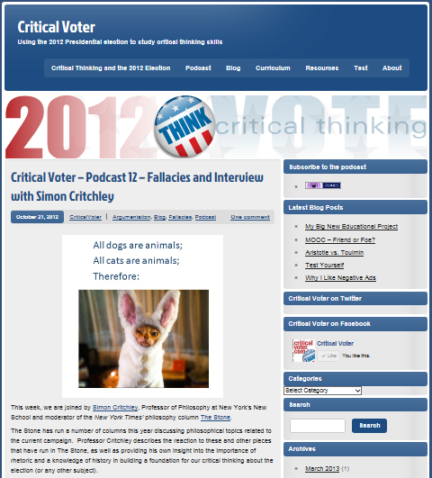
CRITICAL VOTER (www.criticalvoter.com)

Slide 4
Practical critical thinking
Logic
Argumentation
Rhetoric
Media and Information Literacy
Cognitive Science

Slide 5
LOGIC
I’ll never vote for a Republican, because they’re all a bunch of warmongers!
Oh yeah! Well Democrats are all soft on defense! Which is why I’m not voting for Hillary Clinton!

Slide 6
Deductive argument
Premise 1: All Republicans are warmongers.
Premise 2: All warmongers are not people I would vote for.
Conclusion: Therefore, all Republicans are not people I would vote for.

Slide 7
Venn Diagram
Warmongers
People I would vote for
Republicans

Slide 8
Test for quality
Premise 1: All Republicans are warmongers.
Premise 2: All warmongers are not people I would vote for.
Conclusion: Therefore, all Republicans are not people I would vote for.
√ Valid
X Unsound

Slide 9
Example 2
Premise 1: I would never vote for someone soft on defense.
Premise 2: All Democrats are soft on defense.
Premise 3: Hillary Clinton is a Democrat
Conclusion: Therefore, I will not vote for Hillary Clinton.
√ Valid
X Unsound

Slide 10
Inductive logic
Do you think Eric is voting for Trump?
Well he’s been wearing a Trump hat since February, has a Trump bumper sticker on his car, and has voted Republican all his life. So I’m guessing yes.

Slide 11
Inductive argument
Premise 1: Eric has always voted for Republicans in Presidential elections.
Premise 2: Eric has been wearing a Trump hat since February.
Premise 3: Eric has a Trump bumper sticker on his car.
Conclusion: Therefore, Eric is voting for Trump.

Slide 12
Argumentation and Persuasion
Logos
Pathos
Ethos
Forensic Arguments
Demonstrative Arguments
Deliberative Arguments

Slide 13
Exercise – negative ads
https://www.youtube.com/watch?v=sWiSFwZJXwE

Slide 14
bias
https://www.youtube.com/watch?v=vJG698U2Mvo

Slide 15
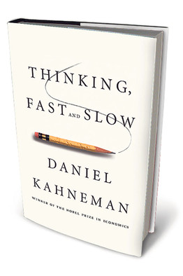
bias
Examples of biases:
Anchoring
Framing
Bandwagon Effect
Halo Effect
Confirmation Bias

Slide 16
Q&A

